Slide 1
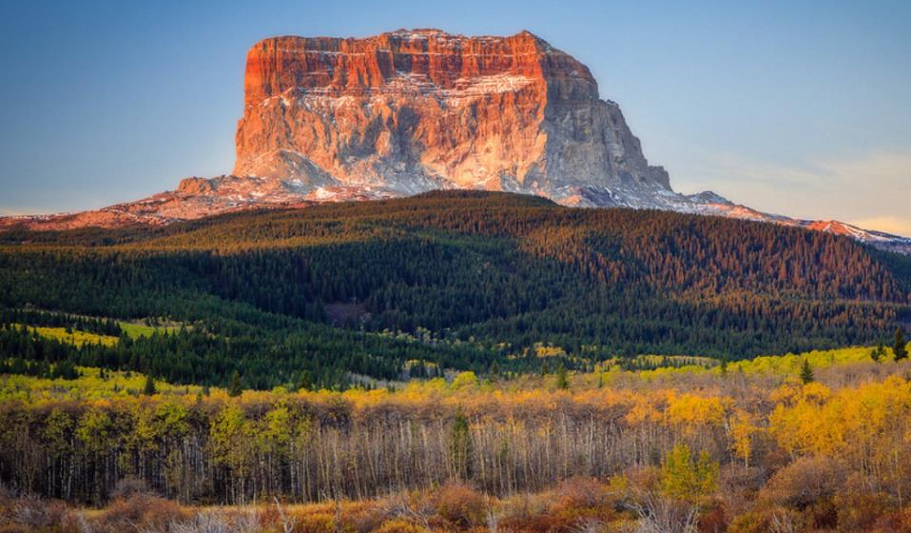
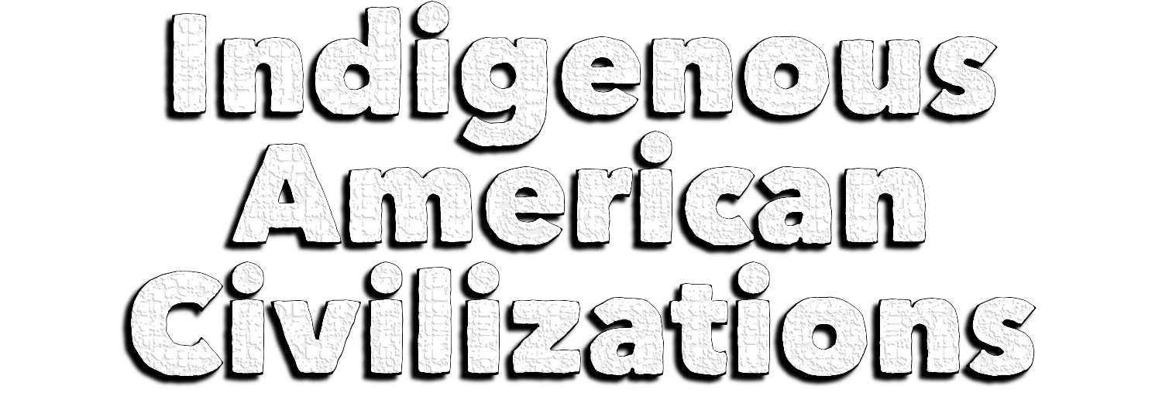
Notes:
Chief Mountain is sacred to the Blackfoot. The mountain marks the boundary between the Blackfoot reservation in Montana and Glacier National Park.

Slide 2
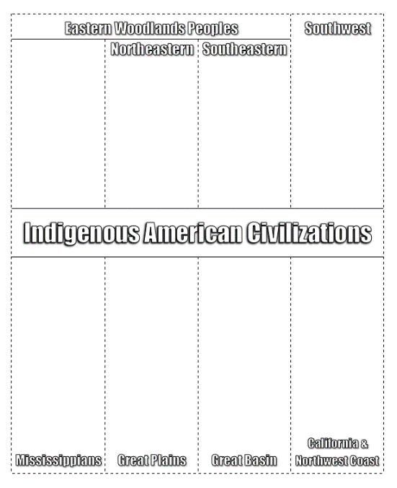
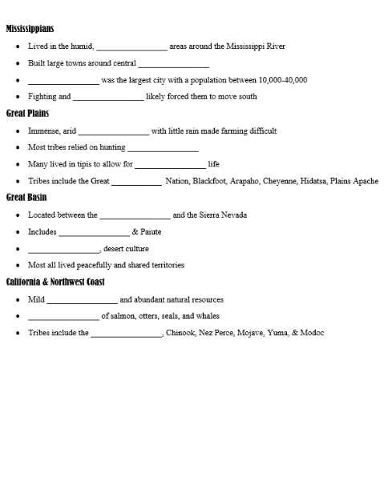
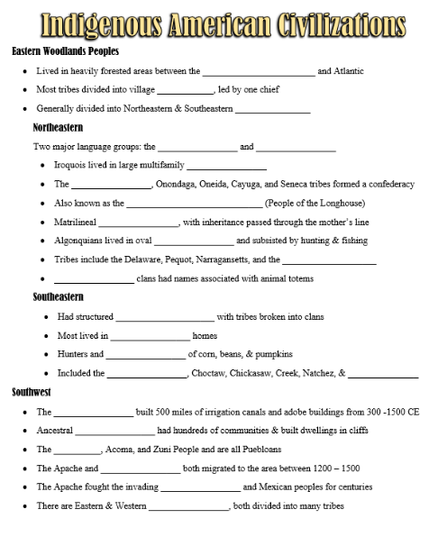

Thank you!
Thank you so much for purchasing this product for your classroom! I very much appreciate your support and business. Please, however, do not post this resource to any webpage, blog, Weebly page or Youtube. This is a violation of our Terms of Use.
Interactive Foldable & Guided Notes:
https://docs.google.com/document/d/15BY5aGJEmiXr0ZcX0brwlnyehM4nhzQM/edit?usp=sharing&ouid=118435158244194289373&rtpof=true&sd=true
Google Doc Guided Notes:
https://docs.google.com/document/d/1h3jhqQE206uA05dwMWukg0R07nVRiAUaAG-Zz1wDxPY/view
Guided Notes Answer Key:
https://docs.google.com/document/d/10doJhynIXoO9hUYsIZGhK6ztknkyVshgnHabRZC_BSo/view
Flipped Classroom Video:
https://youtu.be/-oW_LVKuujc
Google Slides Presentation:
https://docs.google.com/presentation/d/1WdrYgy1BIehMxkEkWl32QPYuehAUsJYIP9oSCQoj9nk/view
Notes:
© Students of History - http://www.teacherspayteachers.com/Store/Students-Of-History

Slide 3
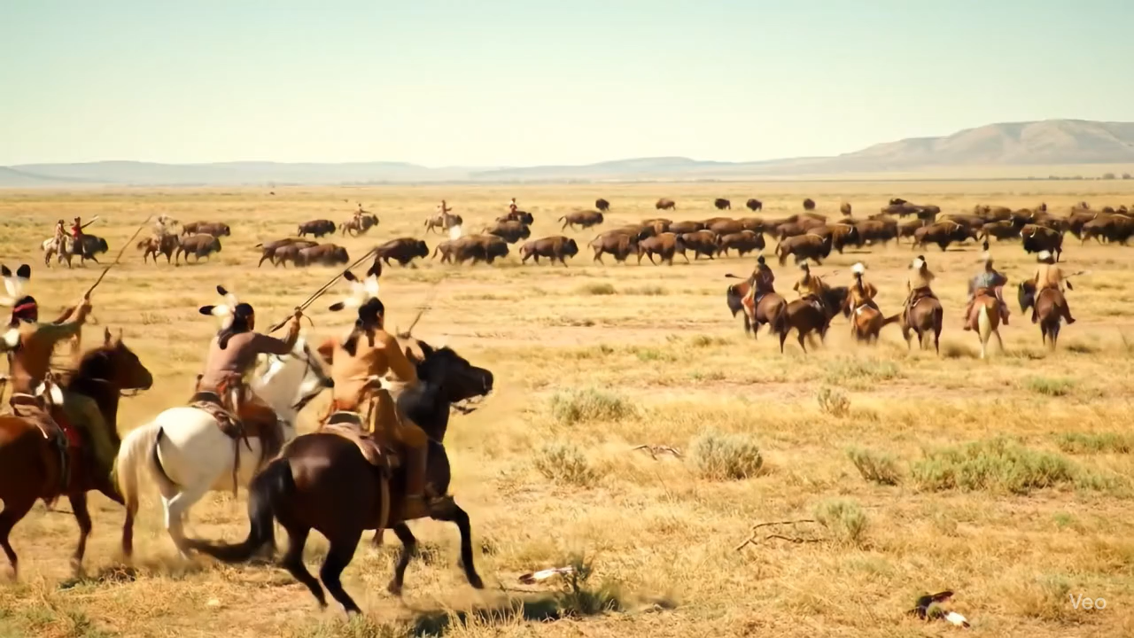
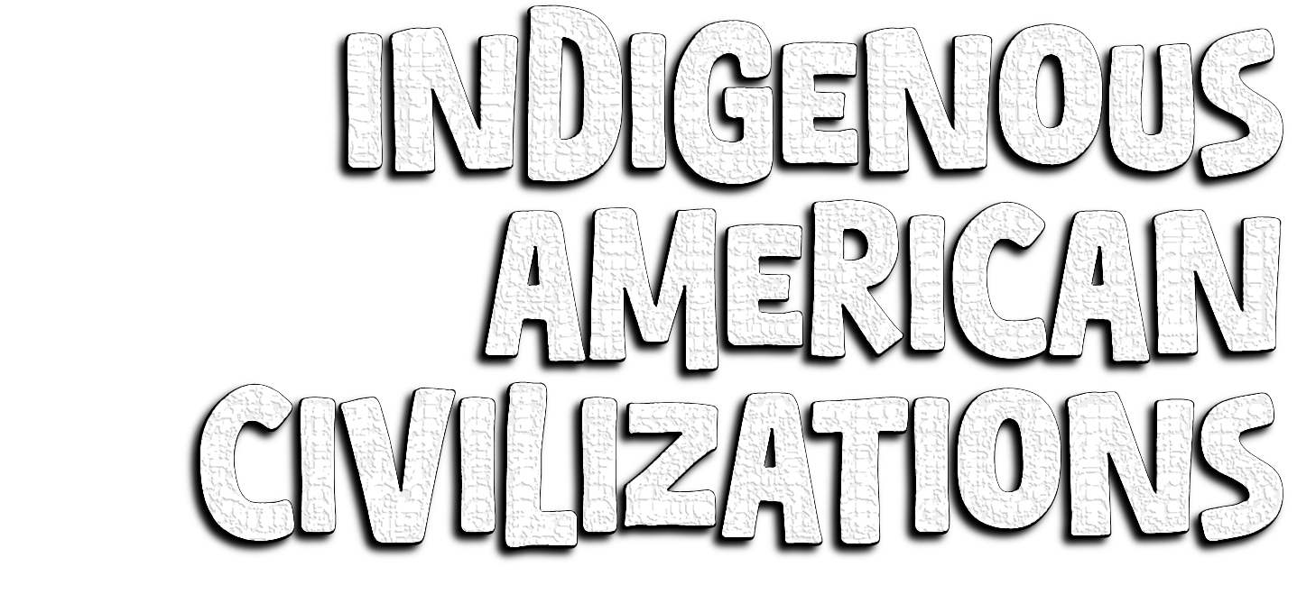
Notes:
Plains Indians on a buffalo hunt.

Slide 4
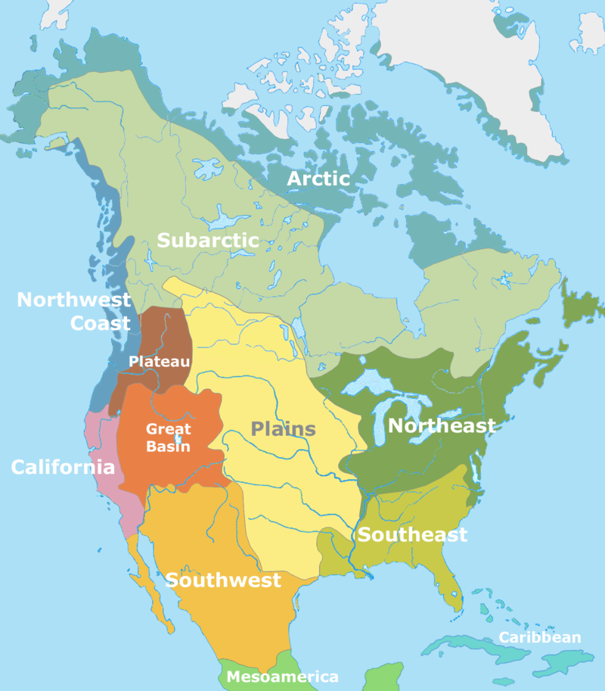
Notes:
Generic map of American Indian tribal regions

Slide 5
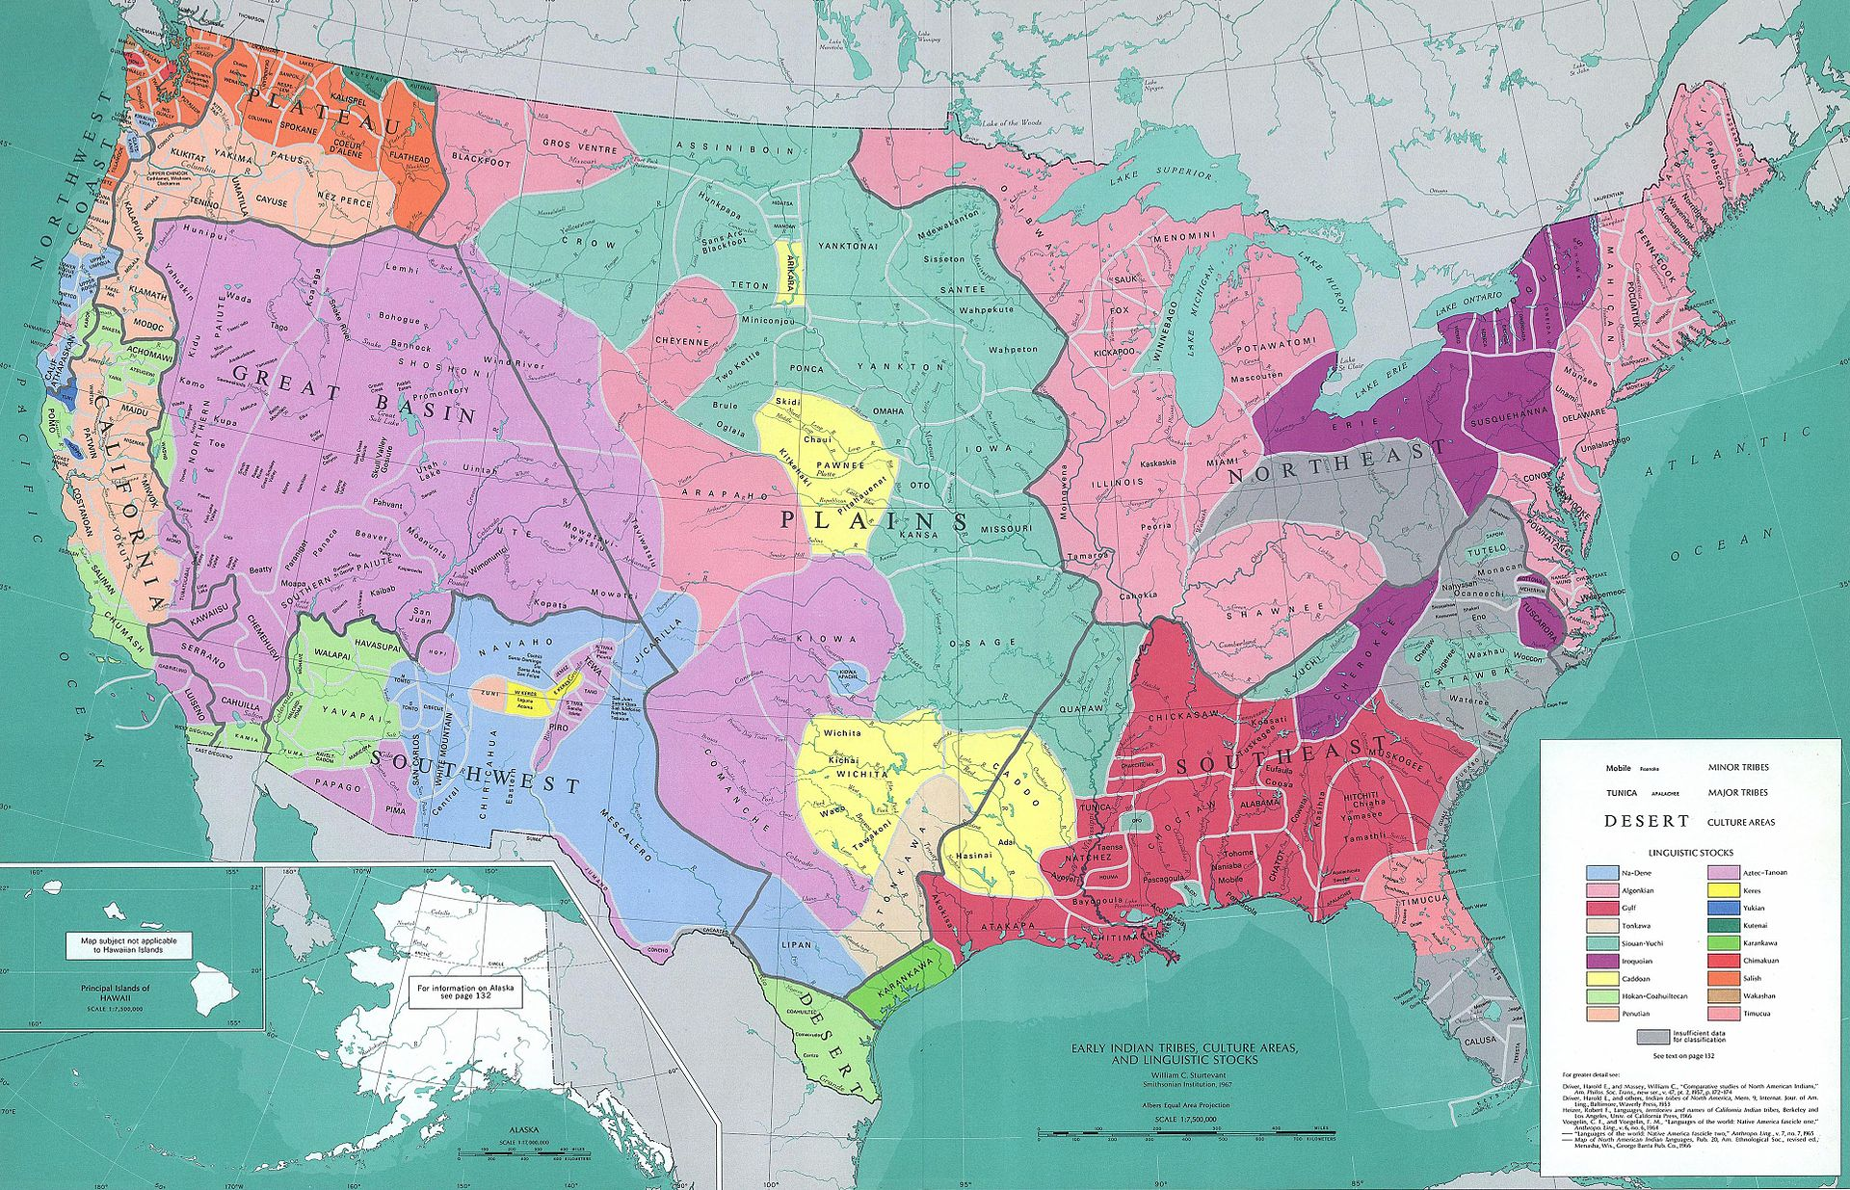
Notes:
Early Native American tribal territories

Slide 6
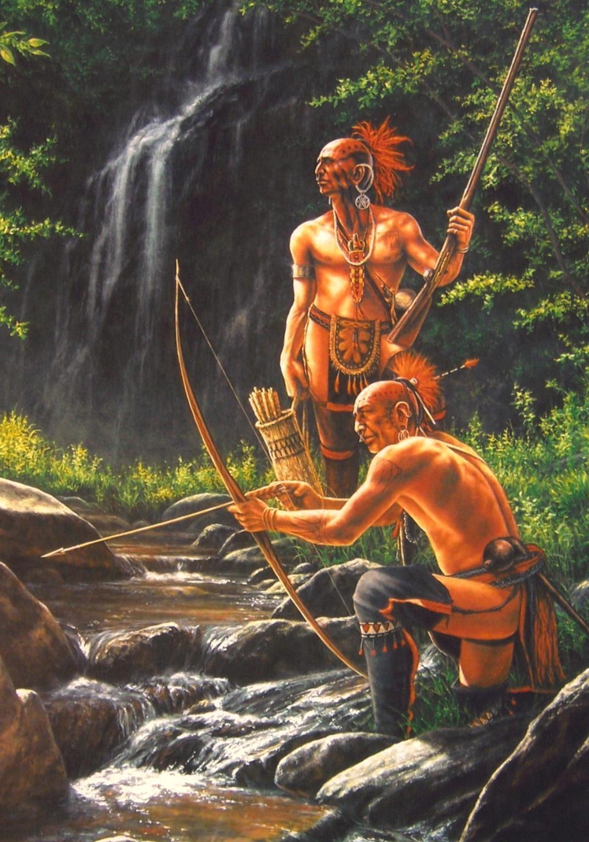
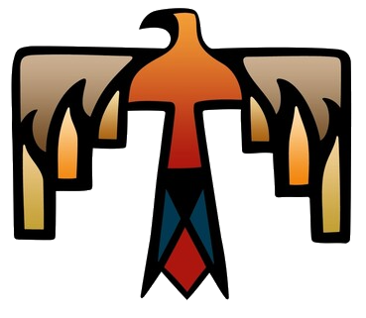
Lived in heavily forested areas between the Appalachians and Atlantic
Most tribes divided into village bands, led by one chief
Generally divided into Northeastern & Southeastern groups
Notes:
The earliest known inhabitants of the Eastern Woodlands were peoples of the Adena and Hopewell cultures,, who inhabited the Ohio and Mississippi river valleys between 800 BCE and 800 CE. They had a tradition of building massive earthwork mounds.
The Eastern Woodlands extended roughly from the Atlantic Ocean to the eastern Great Plains, and from the Great Lakes region to the Gulf of Mexico. The Indigenous people of the Eastern Woodlands spoke languages belonging to several language groups, including Algonquian, Iroquoian, Muskogean, and Siouan, as well as apparently isolated languages such as Calusa, Natchez, Timucua, Tunica and Yuchi. Many of these languages are still spoken today.

Slide 7

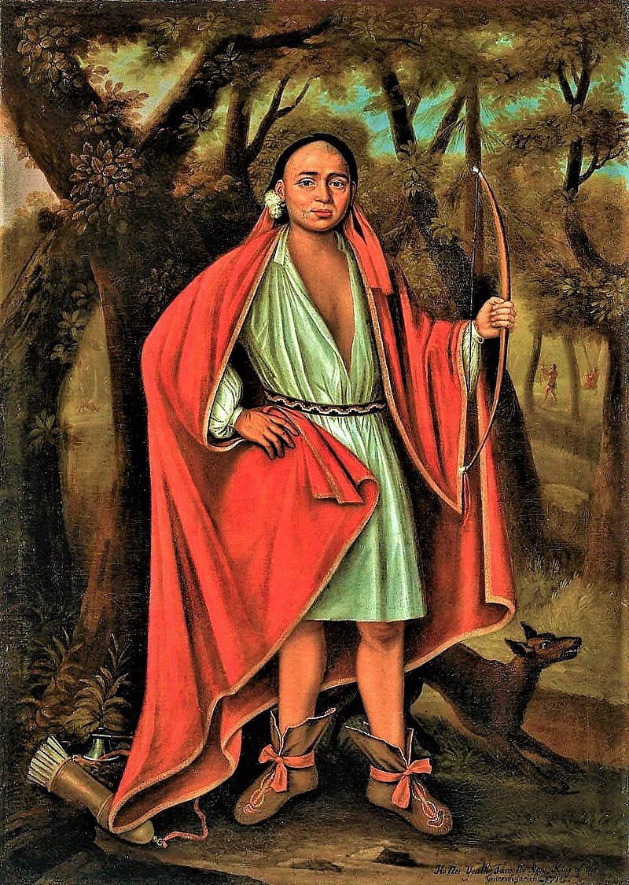
Two major language groups: the Iroquois and Algonquians
Iroquois lived in large multifamily longhouses
The Mohawk, Onondaga, Oneida, Cayuga, and Seneca tribes formed a confederacy
Also known as the Haudenosaunee (People of the Longhouse)
Matrilineal kinship, with inheritance passed through the mother’s line
Notes:
The Iroquois League was created to preserve peace between the member nations and protect them against outsiders. A Great Council resolved differences and kept the peace. Individual tribes maintained their sovereignty. There was a bicameral (two-house) legislature, like the US Congress. Representatives were known as sachems. There was an unwritten constitution that described these proceedings at least as early as 1590.
After 1722 the 5 Nations accepted the Tuscarora people from the southeast into their confederacy, as they were also Iroquoian-speaking, and consequently became known as the Six Nations.
Image: Ho Nee Yeath Taw No Row, King of the Generethgarich Whole-length portrait of one of the 'Four Indian Kings' who visited London in 1710

Slide 8
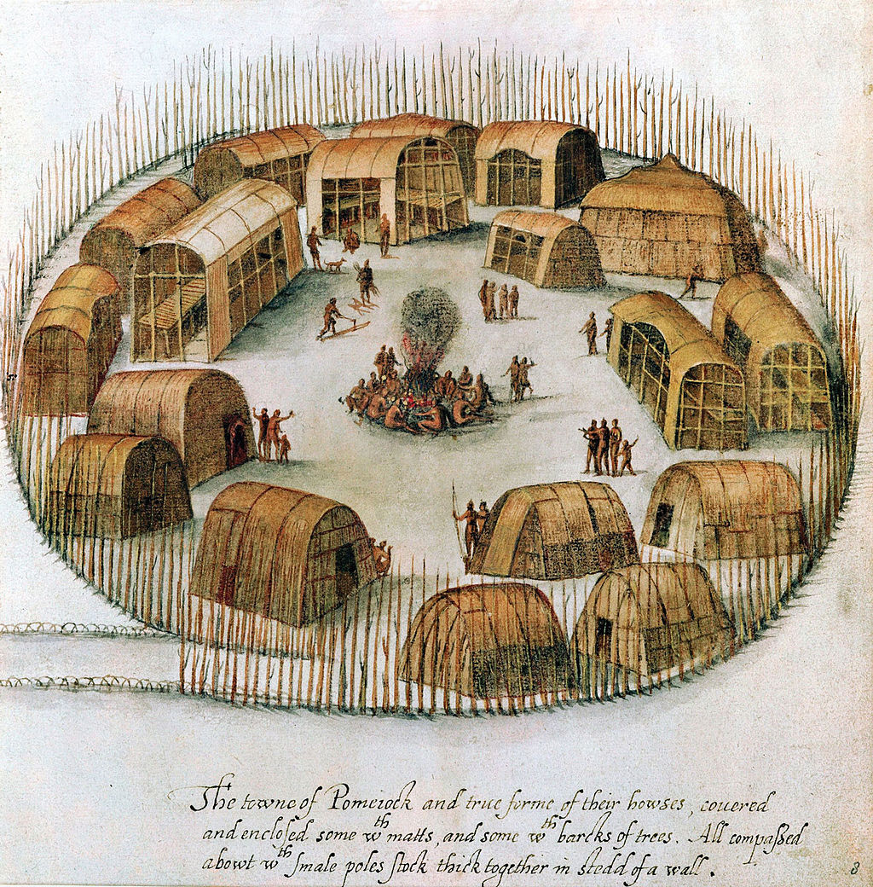
Algonquians lived in oval wigwams and subsisted by hunting & fishing
Tribes include the Delaware, Pequot, Narragansetts, and the Wampanoag
Patrilineal clans had names associated with animal totems
Notes:
Algonquians also included the Powhatan, Miami people, and Leni Lenape. Although these tribes have great differences, they are linked linguistically. They all speak an Algonquin language. They were the first group to encounter the English
Image: A 16th-century sketch of the Algonquian village of Pomeiock.

Slide 9
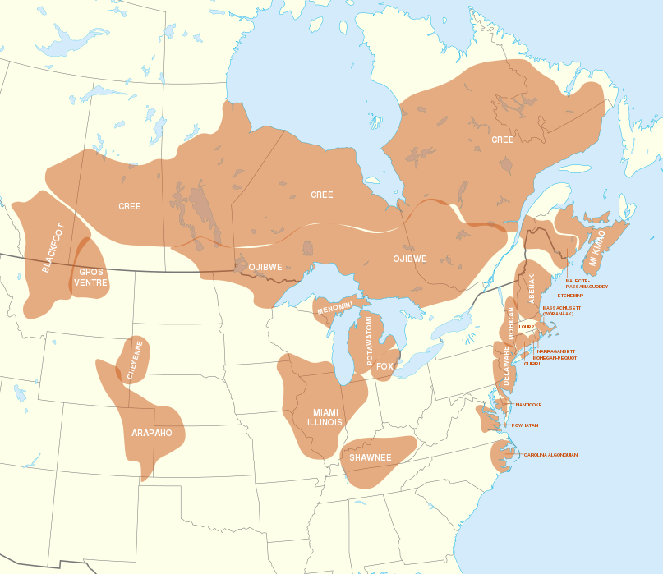
Notes:
Pre-contact distribution of Algonquian languages

Slide 10

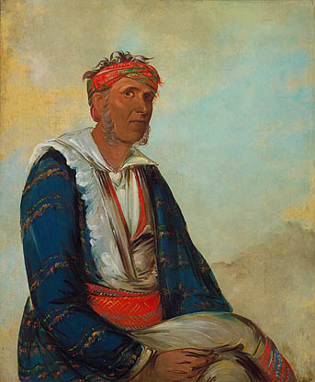
Had structured governments with tribes broken into clans
Most lived in permanent homes
Hunters and farmers of corn, beans, & pumpkins
Included the Cherokee, Choctaw, Chickasaw, Creek, Natchez, & Seminole
Notes:
Clans were related people. When a baby was born, he or she belonged to the mother's clan. Laws varied, but some laws were the same in all tribes. One such law was that you could not marry someone from your own clan.
Eventually, Europeans would describe the Creek, Cherokee, Choctaw, Chickasaw, and Seminole as the “Five Civilized Tribes.”
Cherokee called themselves the Ani-Yunwiya, meaning "principal people". The Booger Dance is a Cherokee traditional dance with masks, performed at night-time around a campfire. "Boogers“ are male dancers with colorful masks that represent evil spirits. The Boogers also represent the malevolent spirits and the dance is to provide protection against the evil spirits.
In 1821, a Cherokee named Sequoyah created a Cherokee syllabary, making reading and writing in Cherokee possible.
The Seminole lived in thatched roof houses known as Chickees.
Creek towns were grouped into white and red categories, set apart for peace ceremonials and war ceremonials, respectively.
Image: Cól-lee, a Cherokee Band Chief, painted by George Catlin, 1834

Slide 11
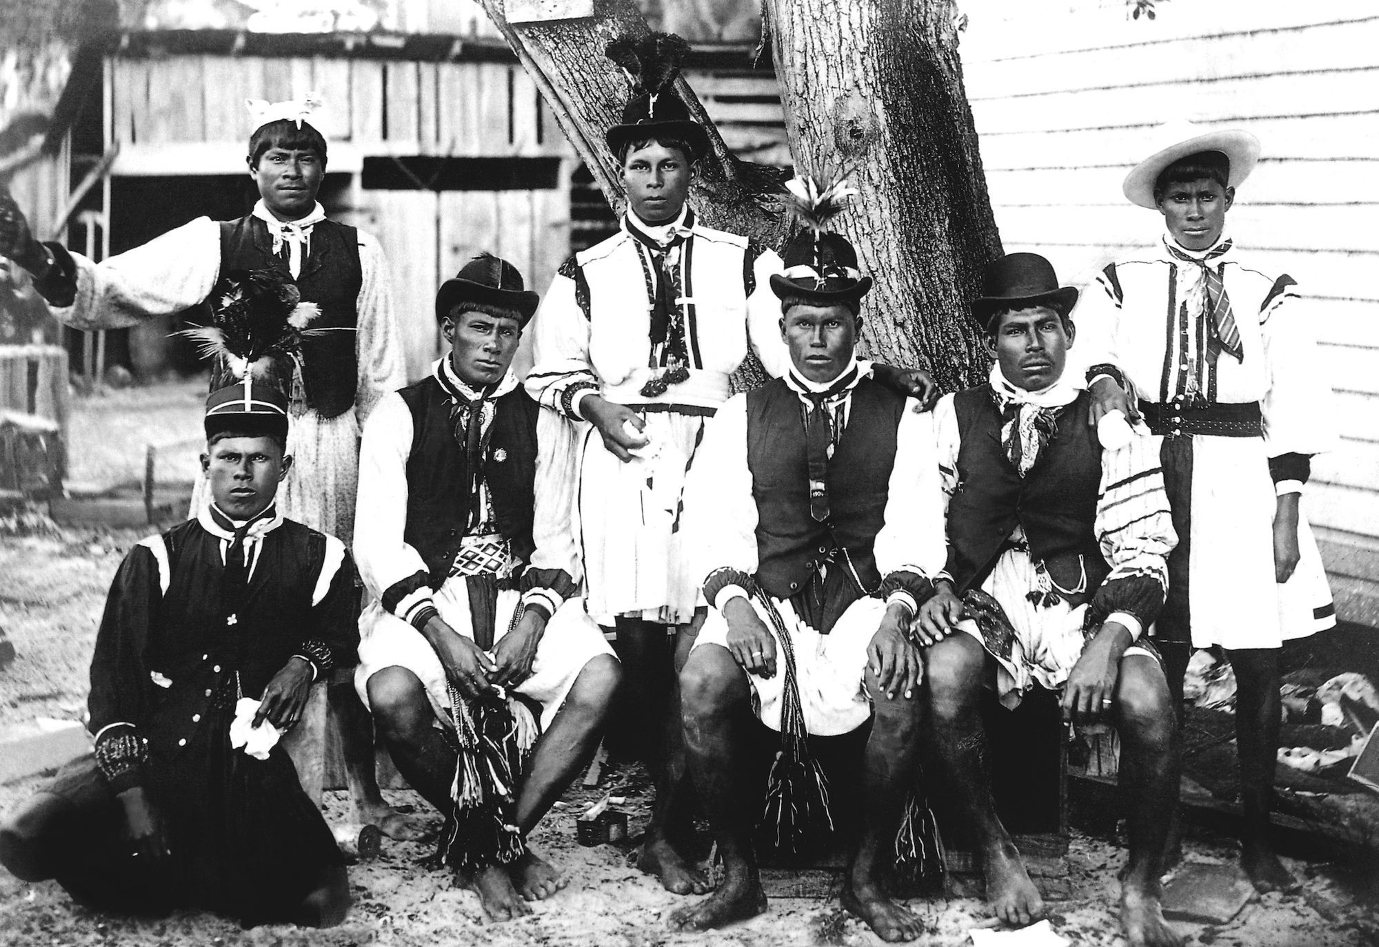
Notes:
A group of young men from the Seminole tribe

Slide 12

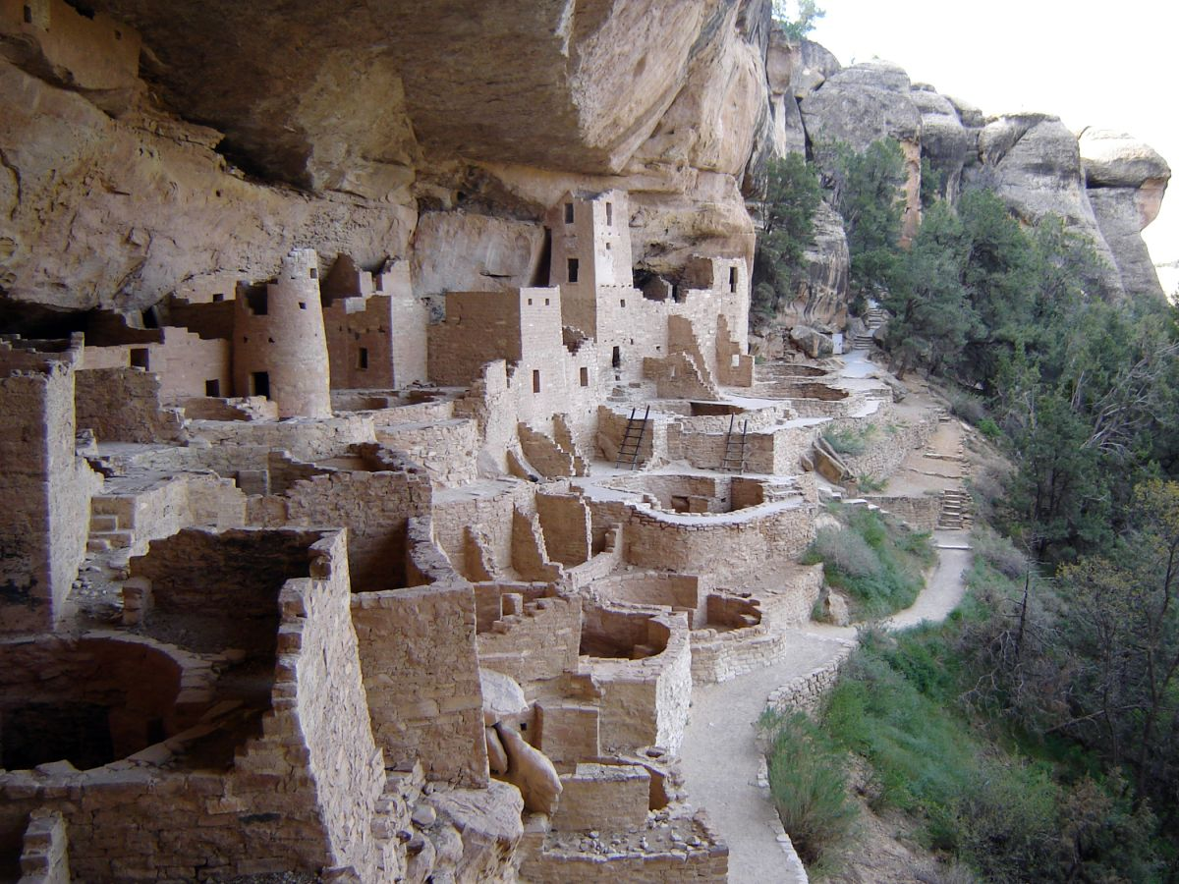
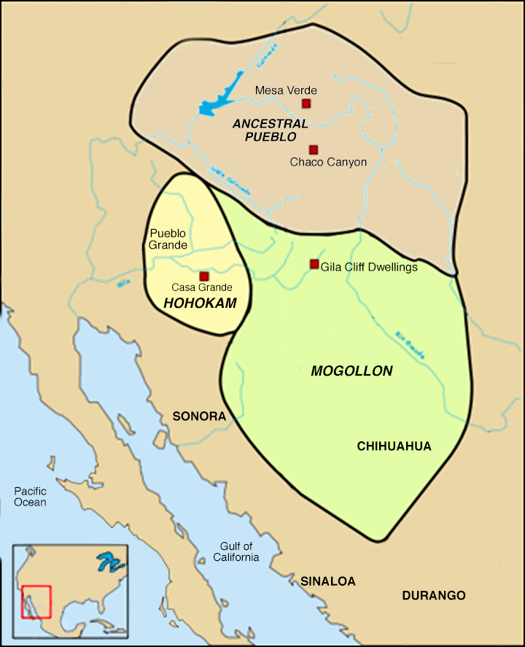
The Hohokams built 500 miles of irrigation canals and adobe buildings from 300 -1500 CE
Ancestral Puebloans had hundreds of communities & built dwellings in cliffs
The Hopi, Acoma, and Zuni People and are all Puebloans
Notes:
The Mogollon are related to the Acoma, Hopi, and Zuni people. The Puebloans share common agricultural, material, and religious practices. Pueblo means "village" in Spanish and was used it to refer to the people's style of dwelling.
The meaning of the word "Hopi" is "behaving one, one who is mannered, civilized, peaceable, polite, who adheres to the Hopi Way. Hopi are organized into matrilineal clans. These clan organizations extend across all villages. Children are named by the women of the father's clan. After the child is introduced to the Sun, the women of the paternal clan gather, and name the child in honor of the father's clan. Children can be given over forty names. The village members decide the common name.

Slide 13

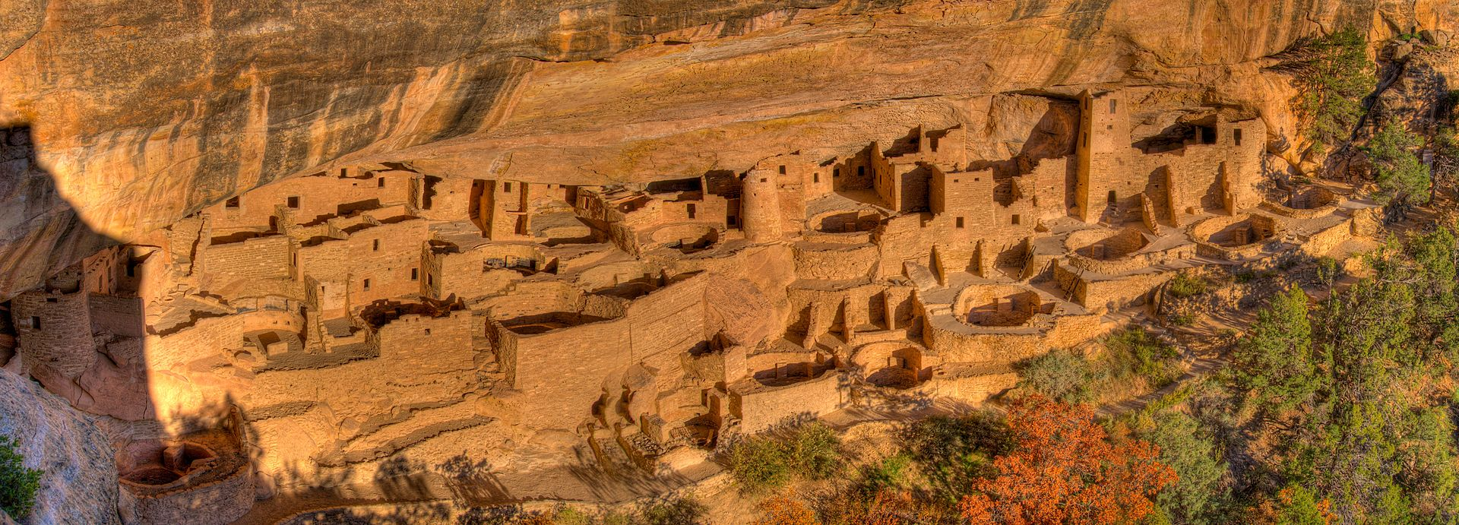
Cliff Palace is the largest cliff dwelling in North America. Built by the Ancestral Puebloans, it is now located in Mesa Verde National Park. Construction and refurbishing of Cliff Palace was continuous from 1190 - 1260 CE, although the major portion of the building was done within a 20-year time span. The Ancestral Puebloans were driven defensible positions like this by increasing competition amidst changing climatic conditions. Cliff Palace was abandoned by 1300 and rediscovered in 1888 by two ranchers looking for stray cattle.
Notes:
Cliff Palace is the largest cliff dwelling in North America. Built by the Ancestral Puebloans, it is now located in Mesa Verde National Park. Construction and refurbishing of Cliff Palace was continuous from 1190 - 1260 CE, although the major portion of the building was done within a 20-year time span. The Ancestral Puebloans were driven defensible positions like this by increasing competition amidst changing climatic conditions. Cliff Palace was abandoned by 1300 and rediscovered in 1888 by two ranchers looking for stray cattle.

Slide 14
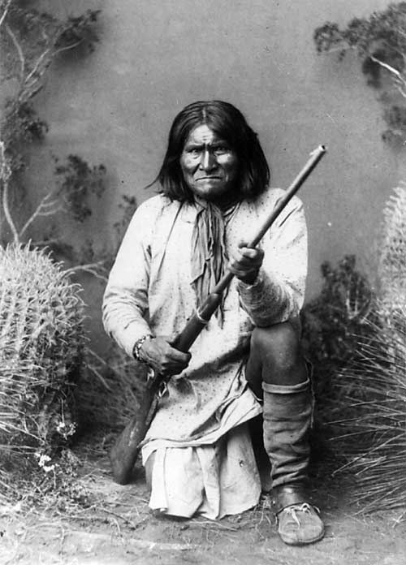
The Apache and Navajo both migrated to the area between 1200 – 1500
The Apache fought the invading Spanish and Mexican peoples for centuries
There are Eastern & Western Apache, both divided into many tribes
Notes:
The term Navajo comes from Spanish missionaries who referred to the Pueblo Indians through this term, although they referred to themselves as the Diné, meaning 'the people'. The Navajo and Apache are distant cousins – both languages are similar and both migrated from northwestern Canada and Alaska. Until contact with the Pueblo and the Spanish peoples, the Navajo were largely hunters and gatherers. The tribe adopted farming techniques from the Pueblo, growing the traditional "Three Sisters" of corn, beans, and squash. Traditional Navajo society was organized through matrilineal kinship; small, bands of related kin made decisions on a consensus basis.
The Eastern Apache, include the Mescalero, Chiricahua, and Kiowa Apache, and Western Apache, which include the Mogollon Apache. Some were farmers others like the Chiricahua were nomadic and aggressive, raiding towns from their strongholds in the Dragoon Mountains.
The Apache did not have a centralized tribal organization. Instead, the band, an autonomous small group within a given locality, was the primary political unit as well as the primary raiding unit. The strongest headman of a band was recognized as an informal chief, and several bands might be united under one leader. Chieftainship was thus an earned privilege rather than a hereditary one.
Picture: Geronimo (the one who yawns) a prominent Apache leader.

Slide 15
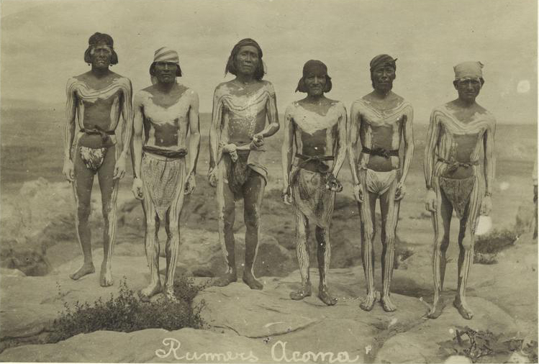
Notes:
Acoma runners, c. 1909

Slide 16

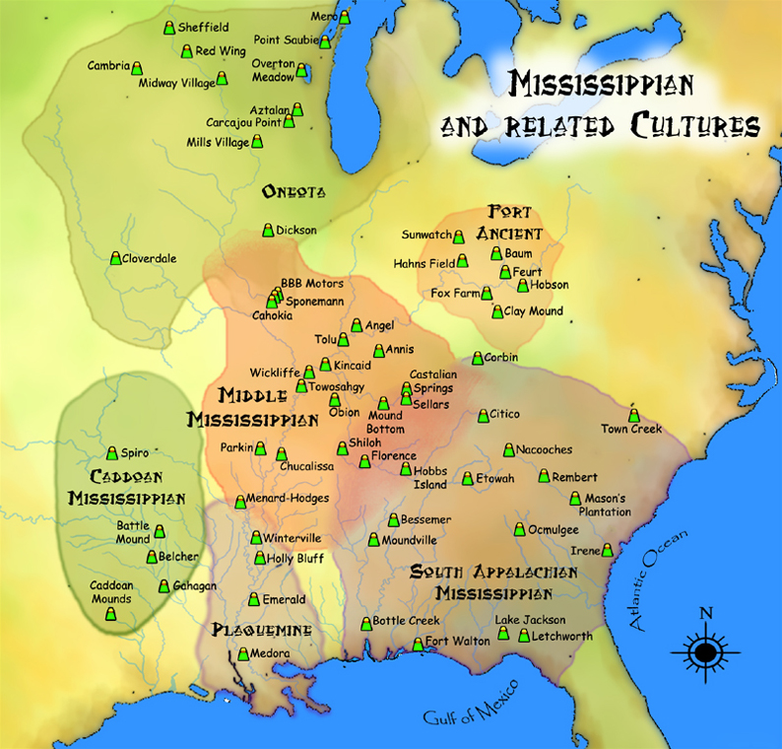
Lived in the humid, temperate areas around the Mississippi River
Built large towns around central plaza
Cahokia was the largest city with a population between 10,000-40,000
Fighting and over-farming likely forced them to move south
Notes:
Cahokia reached its peak around the year 1100 but residents abandoned the city over the next centuries. There was likely an environmental crisis

Slide 17
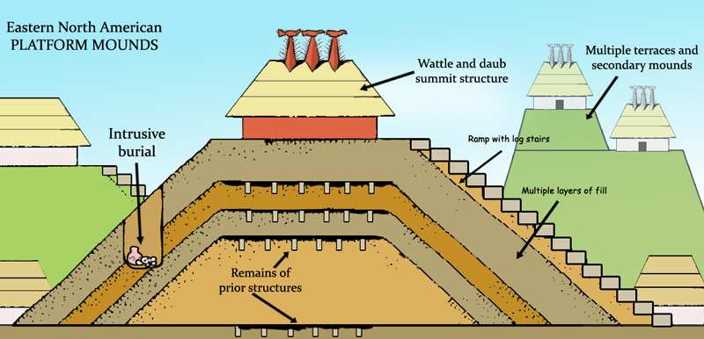
Mississippian period showing the multiple layers of mound construction, mound structures such as temples or mortuaries, ramps with log stairs, and prior structures under later layers, multiple terraces, and intrusive burials
Notes:
Monks Mound was the largest Pre-Columbian earthwork, built around 900–955 CE at the Cahokia Mounds in Illinois. The mound size was calculated as about 100 feet high, 955 feet long, and 775 feet wide. This makes it roughly the same size at its base as the Great Pyramid of Giza
Unlike Egyptian pyramids which were built of stone, the platform mound was constructed almost entirely of layers of basket-transported soil and clay. Because of this construction and its flattened top, over the years, it has retained rainwater within the structure. This has caused slumping,

Slide 18

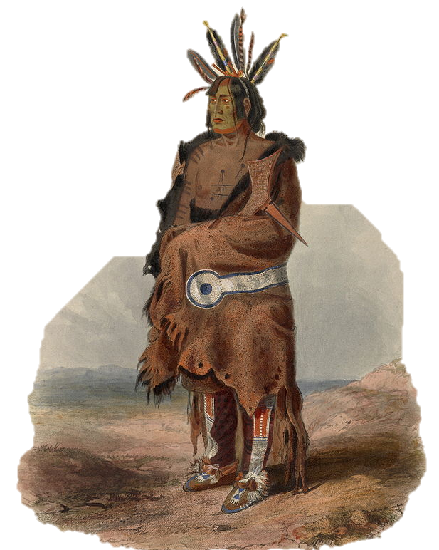
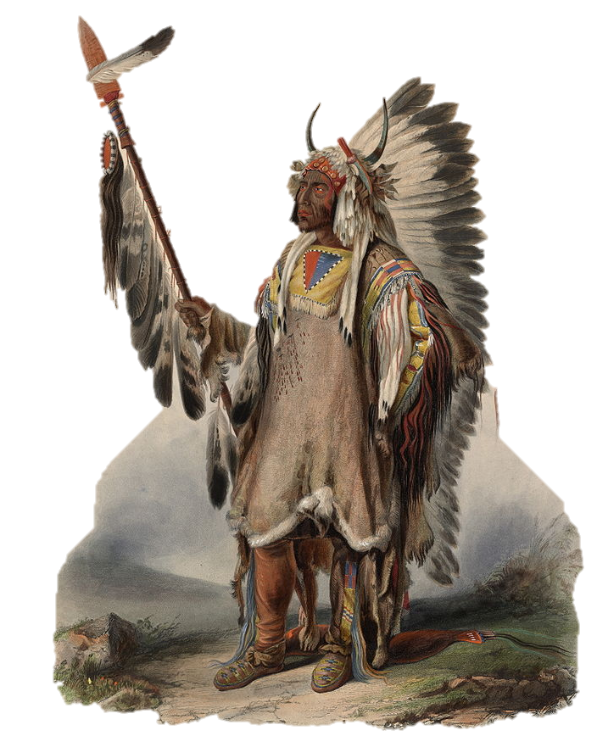
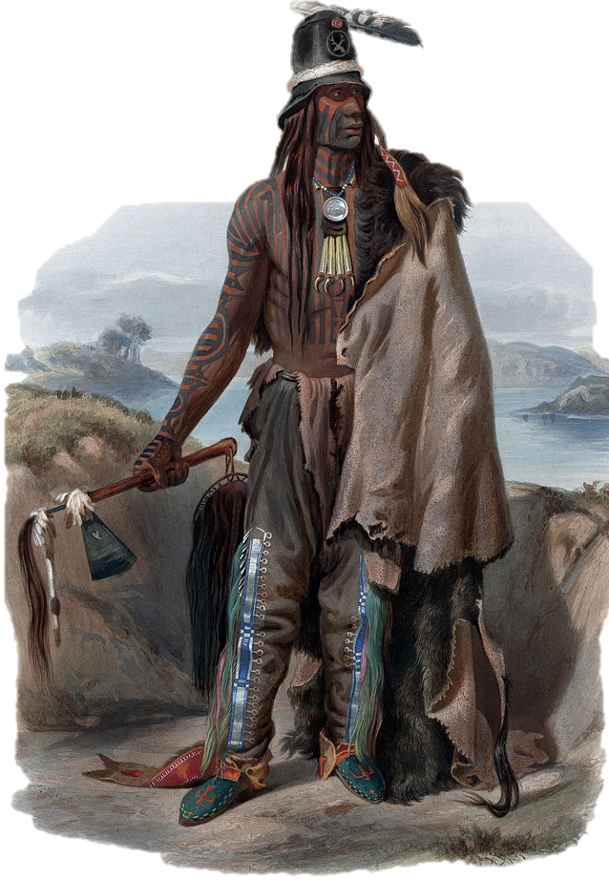
Immense, arid grassland with little rain made farming difficult
Most tribes relied on
hunting buffalo
Many lived in tipis to
allow for nomadic life
Tribes include the Great Sioux Nation, Blackfoot, Arapaho, Cheyenne, Hidatsa, Plains Apache
Notes:
Plains tribes are divided into two groups which overlap. The first were fully nomadic during the 18th and 19th centuries, following the herds of buffalo and included include the Blackfoot, Arapaho, Assiniboine, Cheyenne, Comanche, Crow, Gros Lakota, Lipan, Plains Apache, Plains Cree. The second group were sedentary and, in addition to hunting buffalo, they lived in villages, raised crops, and actively traded with other tribes. These include the Hidatsa, Iowa, Mandan, Missouria, Omaha, Osage, Pawnee, Wichita, and Dakota. Their historic nomadism and armed resistance to domination by the government and military forces of Canada and the United States have made the Plains Indian culture groups an archetype in literature and art for Native Americans everywhere.

Slide 19
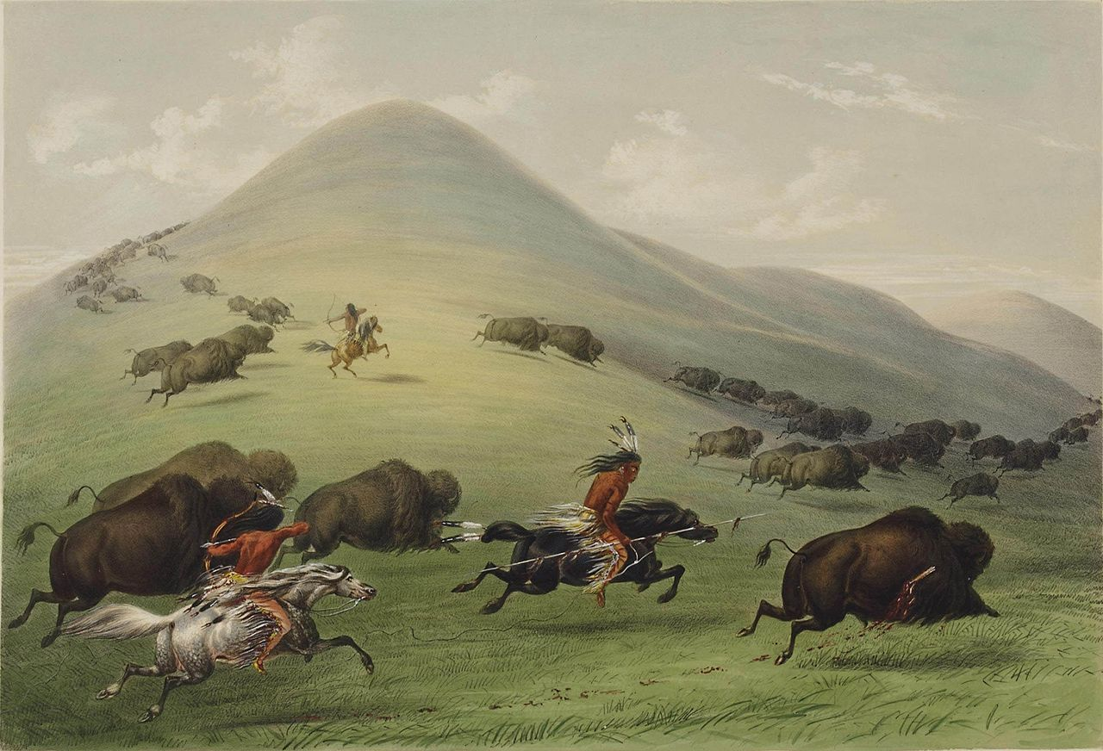
Notes:
George Catlin’s “Buffalo Hunt” from 1844

Slide 20
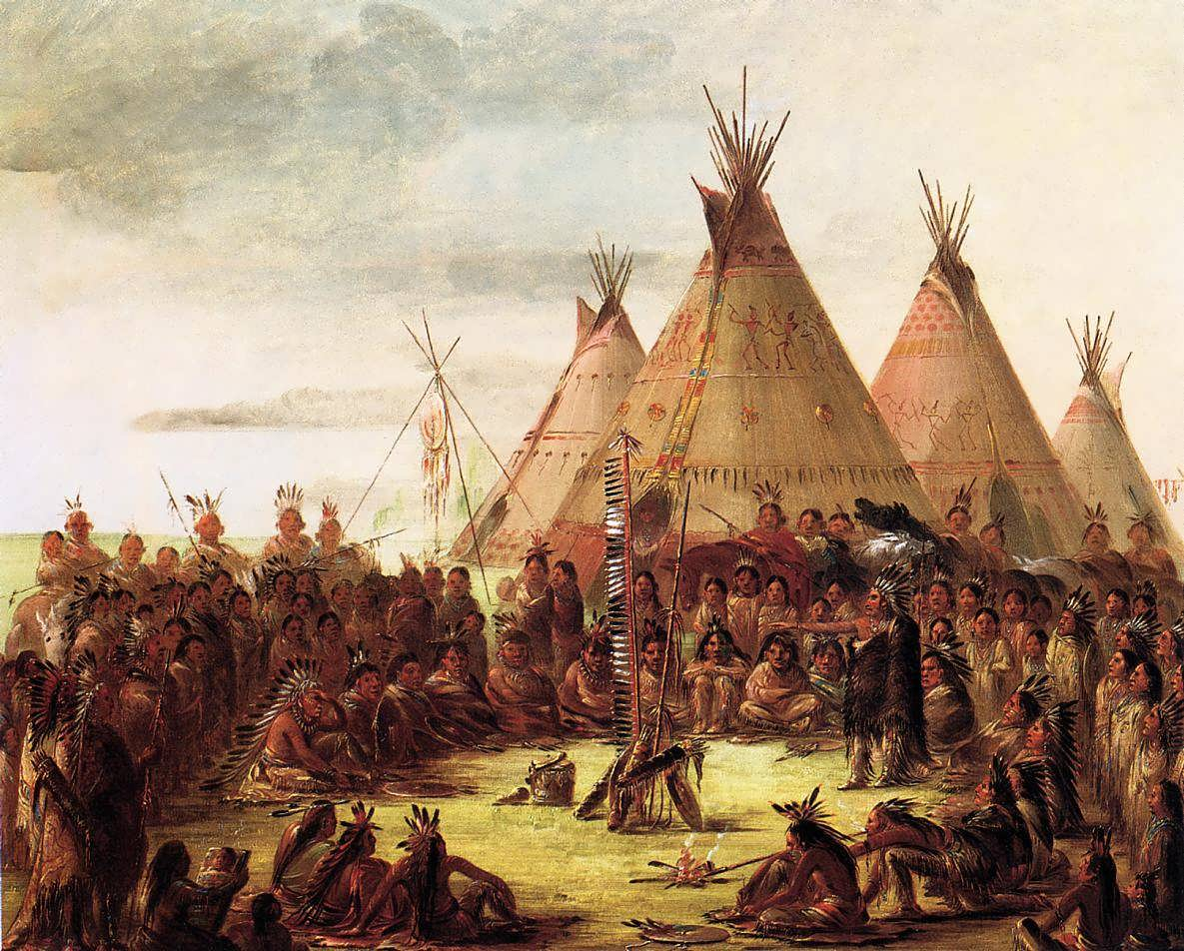
Notes:
Tipis painted by George Catlin in the 1830s

Slide 21
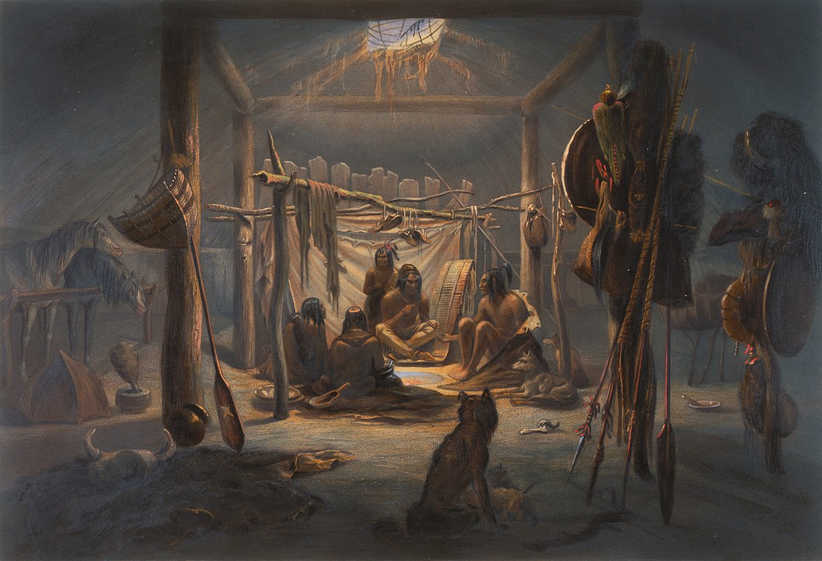
Notes:
The Interior of the Hut of a Mandan Chief by Karl Bodmer 1833 – 1834 by Karl Bodmer from his travel to the Mandan 1833-1834

Slide 22
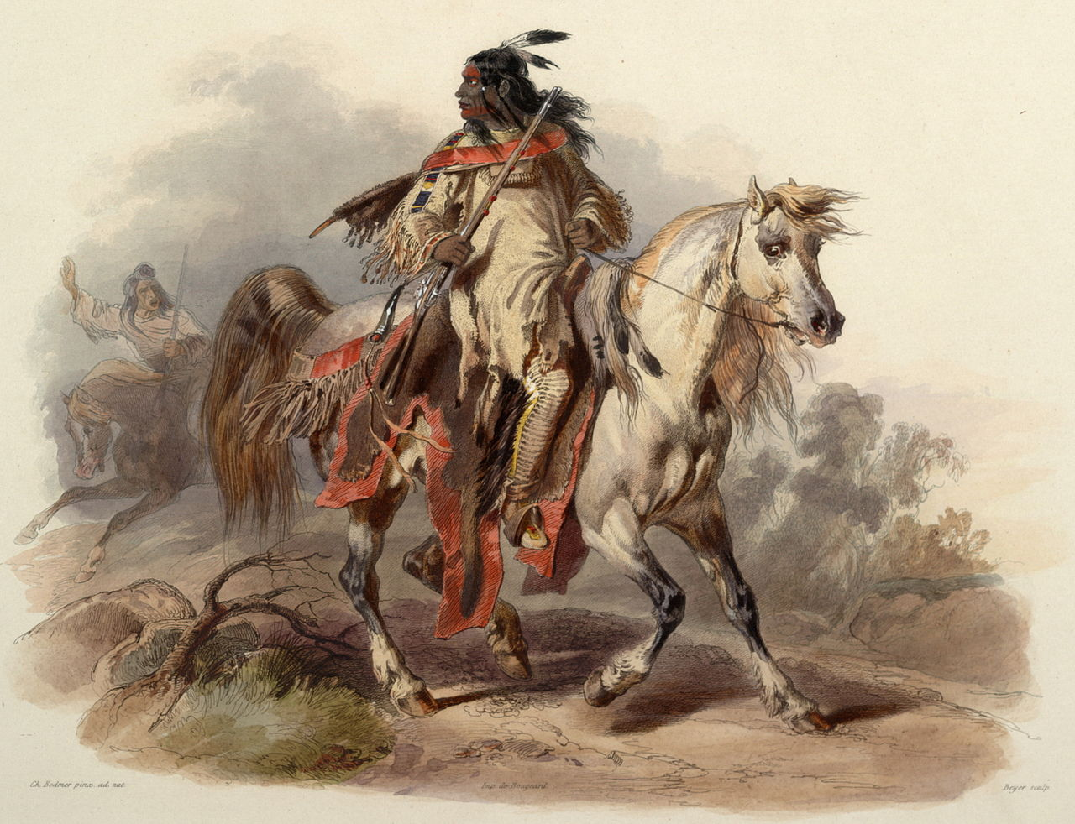
Notes:
Mounted Blackfoot warrior on horse painted from life by Karl Bodmer.

Slide 23
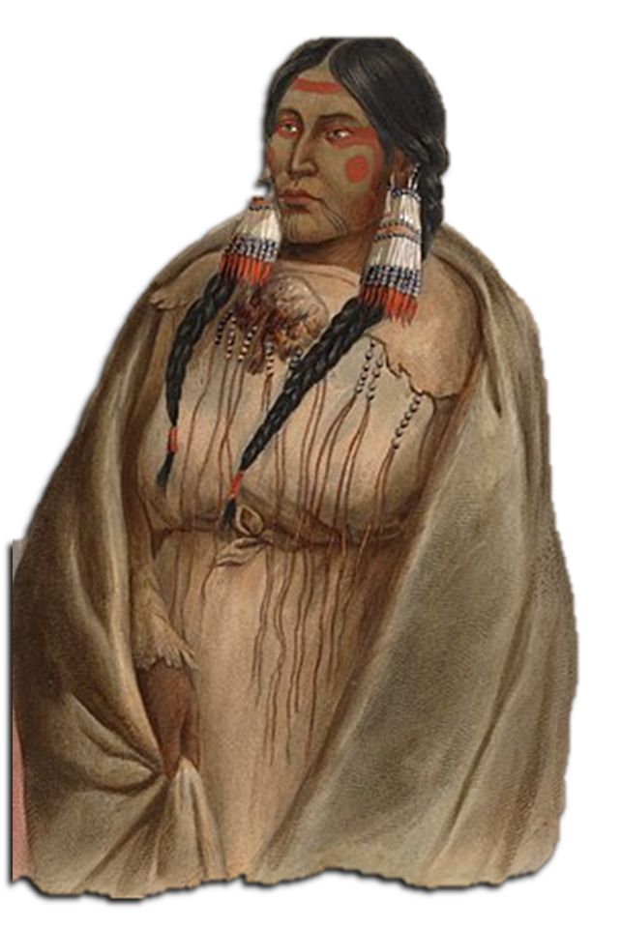

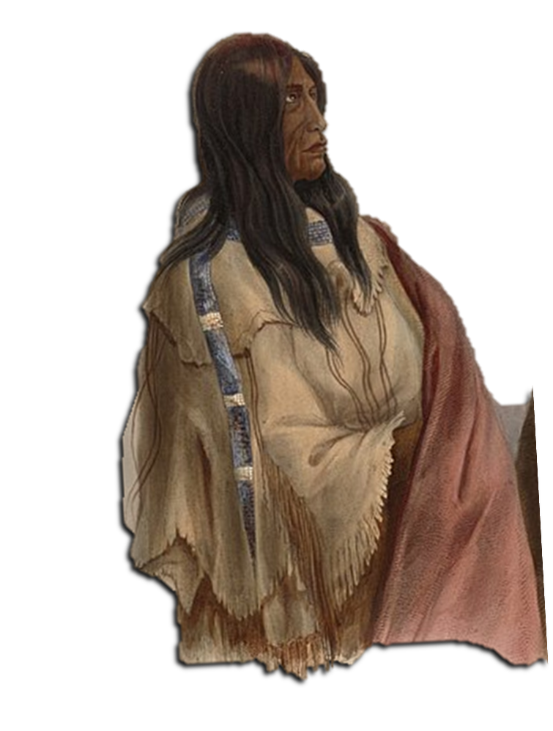
Located between the Rocky Mountains and the Sierra Nevada
Includes Shoshone & Paiute
Nomadic, desert culture
Most all lived peacefully and shared territories
Notes:
Located in what is now Nevada, and parts of Oregon, California, Idaho, Wyoming, and Utah. Great Basin tribes had no permanent settlements, although winter villages might be revisited winter after winter by the same group of families. In the summer, the largest group was usually the nuclear family due to the low density of food supplies.
Illustration of a Snake woman (left) and a Nehiyaw woman (right), c. 1840–1843, Karl Bodmer

Slide 24
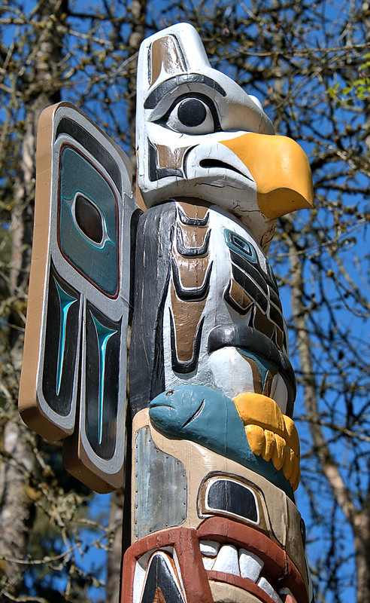
Mild climate and abundant natural resources
Hunting of salmon, otters, seals, and whales
Tribes include the Salish, Chinook, Nez Perce, Mojave, Yuma, & Modoc
Notes:
On the northwest coast the climate and natural resources made possible the rise of a complex Aboriginal culture. The people who lived in what are today British Columbia, Washington, and Oregon were able to obtain a good living without much effort. They had time and energy to devote to the development of fine arts and crafts and to religious and social ceremonies.
Many tribes, such as the Tlingit (KLIN-kit) and Haida (HY-dah), showed off their status with totem poles. The word totem derives from the Algonquian word odoodem meaning "kinship group". The carvings may symbolize or commemorate ancestors, cultural beliefs that recount familiar legends, clan lineages, or notable events. Thunderbirds (a mythical animal that caused thunder with its wings), ravens, and bears often stared down from many totem poles.
A potlatch is a gift-giving feast practiced by Indigenous peoples of the Pacific Northwest Coast. It involves giving away or destroying valuable items in order to demonstrate a leader's wealth and power. Potlatches are also focused on the reaffirmation of family, clan, and international connections, and the human connection with the supernatural world.
California had many tribes, including the Yurok, Mojave, Pomo, Paiute, and Modoc. Each with distinct linguistic, social, and cultural traditions. Except for the Colorado River peoples (Mojave and Quechan) and perhaps some Chumash groups, California peoples avoided centralized governmental structures at the tribal level; instead, each tribe consisted of several independent geopolitical units, or tribelets.

Slide 25
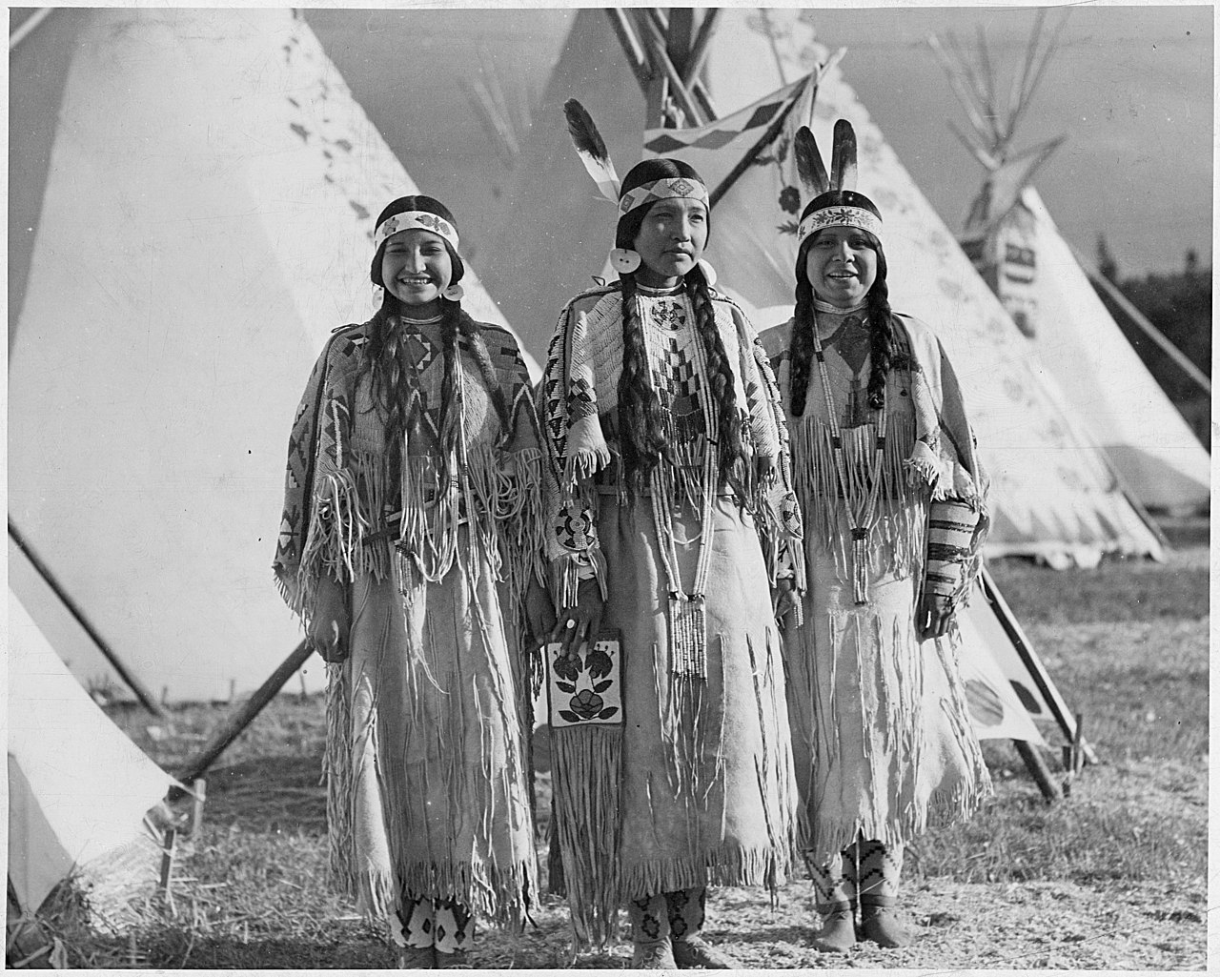
Notes:
Image: Yakama women, a tribe based primarily in eastern Washington state. Two of the women are not married (one with the beaded headband the other with the headband and one eagle feather).

Slide 26

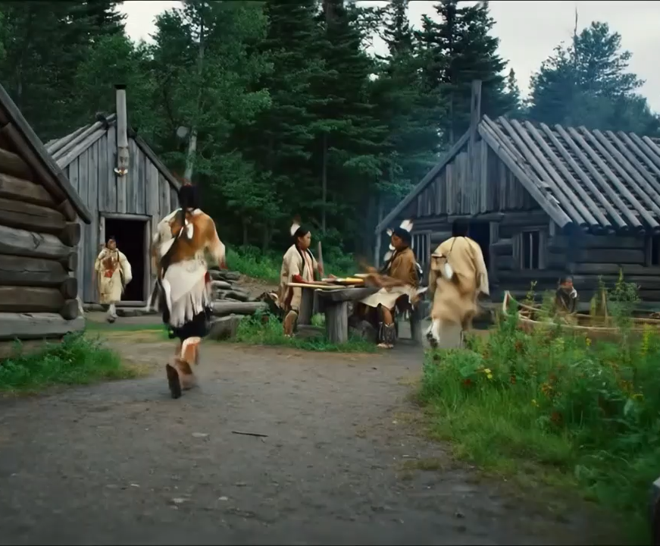
Choose one Indigenous American culture area and describe two ways the people in that region adapted to their environment. Be sure to include how these adaptations shaped their daily life or society.

